Slide 1
Python Quick Camp
TDWI Accelerate - October 2017
Paul Boal - @paulboal

Slide 2
Purpose
Understand the latest trends in Python as a data science tool
Use Python to load, enrich, and analyze real-world data
Manage data using high-performance data structures
pandas, numpy
Visualize data and relationships using plots
matplotlib, pandas, seaborn, plotly, bokeh
Organize complex code libraries using Python modules

Slide 3
Agenda
What’s going on with Python?
Python Quick Camp
Python 101
Real-world scenario
Getting data
Formatting data
Enriching data
Data profiling and analysis
Exercises
Q&A

Slide 4
Universities are Teaching Python
What’s going on with Python?
Fastest growing Q&A topic, especially in colleges and universities.
Growth driven almost entirely from pandas, numpy, matplotlib
https://stackoverflow.blog/2017/09/14/python-growing-quickly/

Slide 5
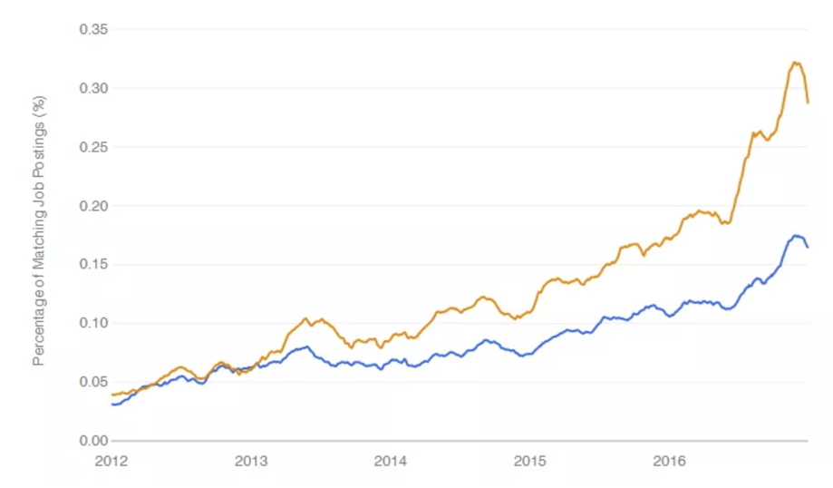
Python is on the rise
What’s going on with Python?
Growing faster than R as a requirement for data science related jobs.
Second only to SQL in technical skills required by a data scientist.
https://www.r-bloggers.com/data-science-job-report-2017-r-passes-sas-but-python-leaves-them-both-behind/

Slide 6
Why choose Python for Data Science?
What’s going on with Python?
A multi-purpose language
Easy to learn syntax
Interactive and reproducible plots
Large and growing data and analytics libraries
Integration with big data platforms (e.g. Spark)
Build complete applications in a single language
Multiple ways to interact with Python: command line, IDE, notebook
https://www.datacamp.com/community/tutorials/r-or-python-for-data-analysis#gs.JoPn0p4

Slide 7
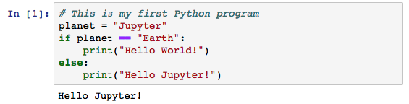
Hello Jupyter!
Introducing Jupyter
Comments are preceded by #.
Variables get assigned values with =.
Code blocks require consistent indenting.
Function calls use () to pass parameter values.
Jupyter organizes commands into cells that can hold code or documentation, and have results.
Jupyter is an interactive web-based programming notebook that shows commands and results in-line.
Jupyter launches separate Python interpreters for each running notebook.
Notebooks are independent and do not share variables or data back-and-forth.

Slide 8

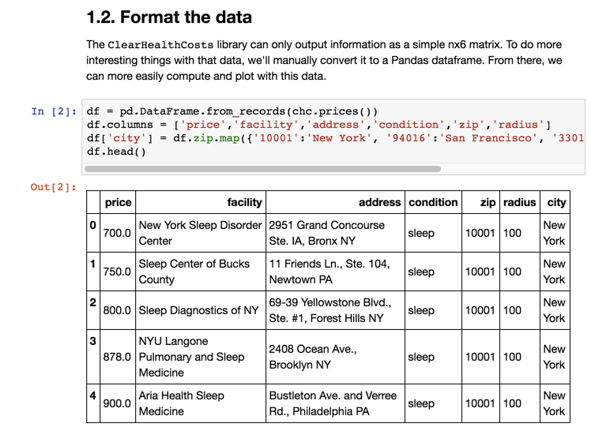
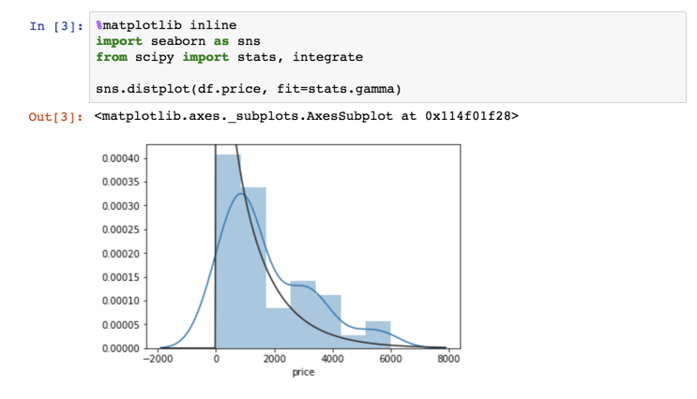
Introducing the Jupyter Notebook
Introducing Jupyter
Jupyter tool bars
Cell types
Documentation
Code
Output
Print statements
Variable contents
Plots
NOTE: Jupyter saves files with a .ipynb extension. These are structured JSON and contain all of the notebook contents including documentation, code, and visible results. The notebook file does not contain a snapshot of the variable contents – that only exists in the current Python instance.

Slide 9
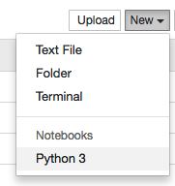

#1 – First Notebook
Create a new Python Notebook in Jupyter
Write your hello world program
Run the current cell with Shift-Enter

Slide 10
Introduction
Business Scenario:
Healthcare costs vary dramatically from one facility to the next, even in the same community.
Are there any geographic features that might be tied to those cost patterns?
Steps:
Getting procedure costs
Get facility information
Get additional external data
Review correlations in data

Slide 11
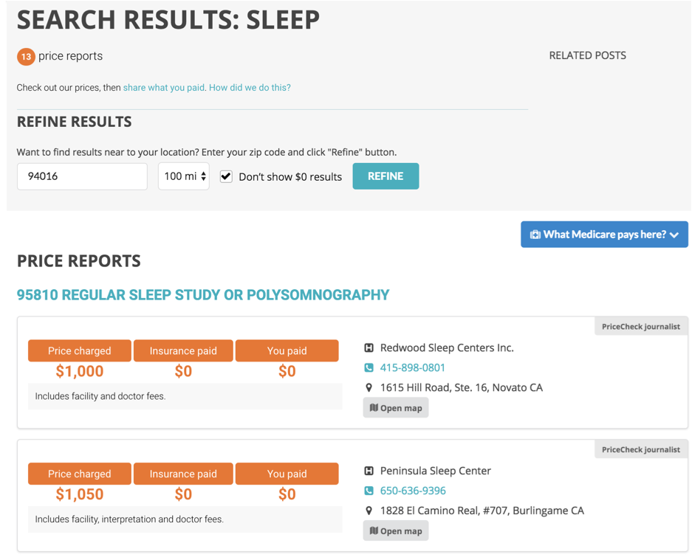
1. Get Procedure Costs
1. Get Procedure Costs
Clear Health Costs is a web site that let’s users search for procedure costs around particular ZIP codes in several large cities.
Our first step is to run searches against this web site and collect the data.
All in fewer than 70 lines of code!

Slide 12
Using Modules
1. Getting procedure costs
from GetPrices import ClearHealthCosts
import pandas as pd
chc = ClearHealthCosts()
chc.get_sleep_prices('10001',100) # New York
chc.get_sleep_prices('94016',100) # San Francisco
chc.get_sleep_prices('33018',100) # Miami
chc.get_sleep_prices('75001',100) # Dallas
In the notebook, all you see are some imports and calls to get_sleep_prices().
All of the code for how to retrieve data from Clear Health Costs is encapsulated in GetPrices.py.
The key to using this personal module is from GetPrices import GetHealthCosts.
This Jupyter cell also imports pandas, but it isn’t used until later.

Slide 13
GetPrices Module: Parse HTML with BeautifulSoup
1.1 Get the data
from bs4 import BeautifulSoup
import requests
class ClearHealthCosts:
...
def get_prices(self, condition, zip, radius):
url = self._get_base_url(condition, zip, radius)
result = requests.get(url)
if result.status_code == 200:
prices = self._parse_pricelist(result.content)
for i in range(0,len(prices)):
prices[i] += [condition, zip, radius]
self._prices += prices
return self
...
More dependencies being imported within the GetPrices module:
BeautifulSoup – parsing HTML
requests – calling web services or pages
Using a class structure to encapsulate variables rather than relying on global variables.
Within a class definition, internal variables and functions are prefixed by self.

Slide 14
Getting Prices: Thinking in Objects
PYTHON BASICS
Procedural Programming:
Functions are managed and run at globally
Variables and data are either local to a function or global
Object-Oriented Programming
Code execution is still linear
Classes hide complex data structures and related functions in one variable
Step 1
Step 1.1()
Step 1.2()
Step 2
Step 2.1()
Step 2.2()
Step 2.3()
Step 1
Step 2
Variable A
Step 1.1()
Step 1.2()
Variable B
Step 2.1()
Step 2.2()
Step 2.3()
Variable A
Variable B
Variable C

Slide 15
Getting Prices: Steps
1.1 Get the data
Generate URL
Pull content from URL
Parse HTML
For each item in the price list
Return list of prices
Parse the price info

Slide 16
Getting Prices: get_sleep_prices()
1.1 Get the data
def get_sleep_prices(self, zip, radius=100):
return self.get_prices('sleep', zip, radius)
def defines a new function or method
All class methods include self as the first parameter
Parameters can have default values, making them optional
This function simply calls another class method
Key goal of object-oriented programming: testability, reusability, flexibility

Slide 17
Getting Prices: get_prices()
1.1 Get the data
def get_prices(self, condition, zip, radius):
url = self._get_base_url(condition, zip, radius)
result = requests.get(url)
if result.status_code == 200:
prices = self._parse_pricelist(result.content)
for i in range(0,len(prices)):
prices[i] += [condition, zip, radius]
self._prices += prices
return self
Call another function to create the URL by concatenating all the pieces together
Use the requests module to call that URL and get the HTML back.
If you get an OK result, then parse the price list and return a list that has the prices and the input parameters.
Strings can be concatenated just by “adding” them together.
def _get_base_url(self, query, zip_code, radius):
return self._base_url+'query='+str(query)+
'&zip_code='+str(zip_code)+
'&radius='+str(radius)+'&submit='

Slide 18
Loops and Lists
PYTHON BASICS
alpha = ['a', 'b', 'c', 'd', 'e']
A list is just a series of values. They don’t have to be the same data type.
To create a list, enclose the list of elements with brackets.
Get a slice of a list using indexes inside of brackets.
Loop through a list by using the range sequence generator.
alpha[0]
'a'
alpha[2:5]
['c', 'd', 'e']
for i in range(len(alpha)):
print(i, ':', alpha[i])
0 : a
1 : b
2 : c
3 : d
4 : e

Slide 19
Getting Prices: parse_pricelist()
1.1 Get the data
def _parse_pricelist(self, page):
prices = []
soup = BeautifulSoup(page, 'html.parser')
items = soup.findAll('div', 'ui grid segment')
for item in items:
price = self._parse_price(item)
prices.append(price)
return prices
Create an empty list for storing results.
BeautifulSoup’s findAll function returns a list of all HTML elements of a given type (div) with certain classes (ui grid segment).
We can also just loop over the elements in a list.
The append just adds the next set of information to the end of the prices list.

Slide 20
Processing Data: Introducing the DataFrame
1.2 Format the data

Slide 21
Making Data Readable: Code to Descriptions Maps
1.2 Format the data

Slide 22
Visualizing Price Distribution: Histograms
1.3 Quick data profiling

Slide 23
Plotting Libraries
1.3 Quick data profiling
Package | Uses
matplotlib | Basic plotting capabilities following the paradigms from Matlab designed for scientific publications. Not built with web based notebooks in mind first, but interactive charts are available.
pandas | DataFrames have built-in plotting functions that use matplotlib under the hood.
seaborn | This library makes the default matplotlib plots prettier and adds many functions to make common plotting activities easier.
plotly | Plot.ly is much more than just a plotting library. It’s a comprehensive web service that gives analysts a way to manage and share data, code, and visualizations. Basic and public usage is free, but enterprise services are paid.
bokeh | An Open Source plotting library that makes interactive web graphics easier to create within environments like Jupyter.

Slide 24
Cleaning Bad Data: Filtering a DataFrame
1.4 Check for bad data

Slide 25
Drill Down: Histograms by Series
1.5 Break things down

Slide 26
2. Getting more information about these facilities
2. Get Facility Information

Slide 27
Type of Facility: Natural Language Processing
2.1 Classifying the facilities

Slide 28
Labeling Facility Types: Loops and Conditions
2.2 Label the clusters

Slide 29
Looking at Facility Types: Histograms and Bars
2.3 Compare the distributions by label

Slide 30
3. Get Additional External Data
3. Bring in external data

Slide 31
Clean Addresses: Google Maps Geocoding
3.1 Geocode addresses

Slide 32
Checkpoint Your Data: Saving and Loading Excel
3.1 Geocode addresses

Slide 33
Get Local Population: DataFrames as Lookups
3.2 Census data

Slide 34
Plotting Relationships: Scatterplot / LM Plot
3.2 Census data

Slide 35
4. Review Correlations in Data
4. Look at correlations

Slide 36
Be a Lazy Programmer: Lists, Loops, and Lambda
4.1 Pull in several variables from census

Slide 37
Scatterplot Matrix
4.2 Correlation plot with Plotly

Slide 38
Plotly Gallery

Slide 39
What Else Can I do with Python?

Slide 40
Review of Topics
Variables
Loops
Flow control
Functions
Modules
Web requests
Lists
Dictionaries
Pandas Series
Pandas DataFrames
Plotting
Reading / Writing Excel

